Slide 1
Materi – 02
Manajemen Perkantoran
sebagai Cabang
Ilmu Manajemen

Slide 2
Materi – 02
Manajemen Perkantoran sebagai Cabang Imu Manajemen
Akar Ilmu Manajemen Perkantoran
Eksistensi informasi dalam organisasi
Eksistensi informasi dalam manajemen
Pengertian Manajemen Perkantoran
Ruang Lingkup Manajemen Perkantoran

Slide 3
Akar Ilmu Manajemen Perkantoran
Management
Scientific Management
(Frederick Winslow Taylor, 1911)
The Institute of Administrative Management, (Rao, M.E.T. (2000:16)
Nanda, J.K. (2006). Management Thought. Sarup & Sons., h. 88
Office Management
Scientific Office Management
(William Henry Leffingwell, 1917)
Office Management as that branch of management which is concerned with the services of obtaining, recording and analyzing information of planning and of communicating by means of which the management of a business safeguards its assets, promotes its affairs and achieve its objectives

Slide 4
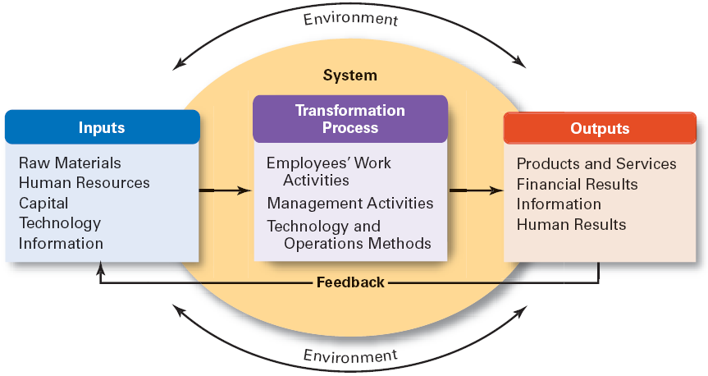
Eksistensi Informasi dalam Organisasi
Organization as an Open System
Robbins, S.P., Coulter, M. (2010). Management. 11th Edition. Pearson Education. h.36

Slide 5
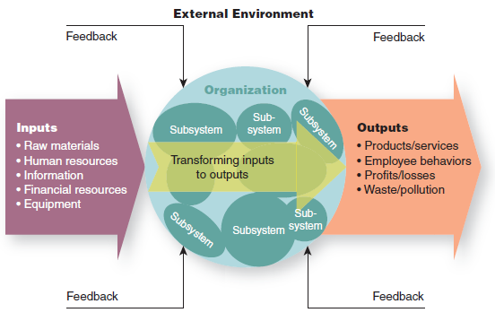
Eksistensi Informasi dalam Organisasi
Open-Systems Perspective of Organizations
Mcshane, S.L., Glinow, M.A.V., (2009). Organizational Behavior. McGraw Hill., h.8

Slide 6
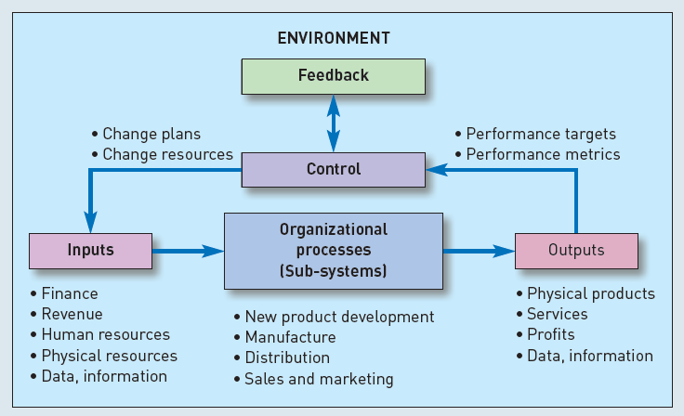
Eksistensi Informasi dalam Organisasi
The Organizational System
Chaffey, D., Wood, S., (2005). Business Information Management:
Improving Performance Using Information Systems. Prentice Hall., h. 27

Slide 7
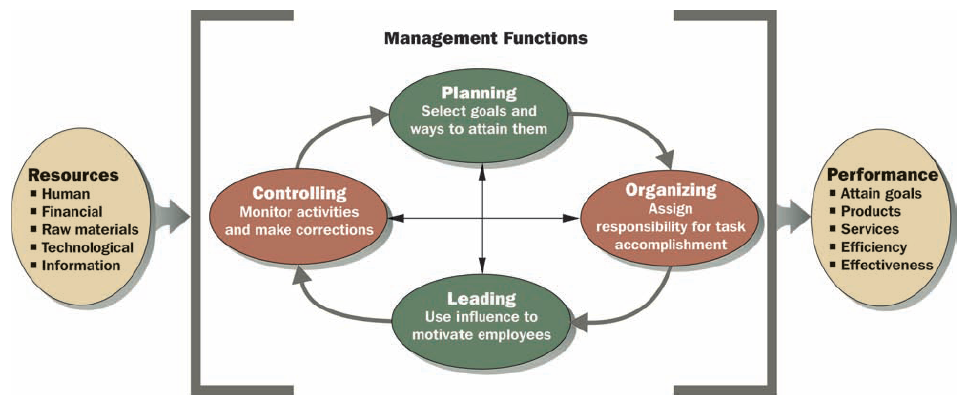
Eksistensi Informasi dalam Perspektif Manajemen
The Process of Management
Daft, R.L., (2007). Management. 8th Edition. Thomson. h 8

Slide 8
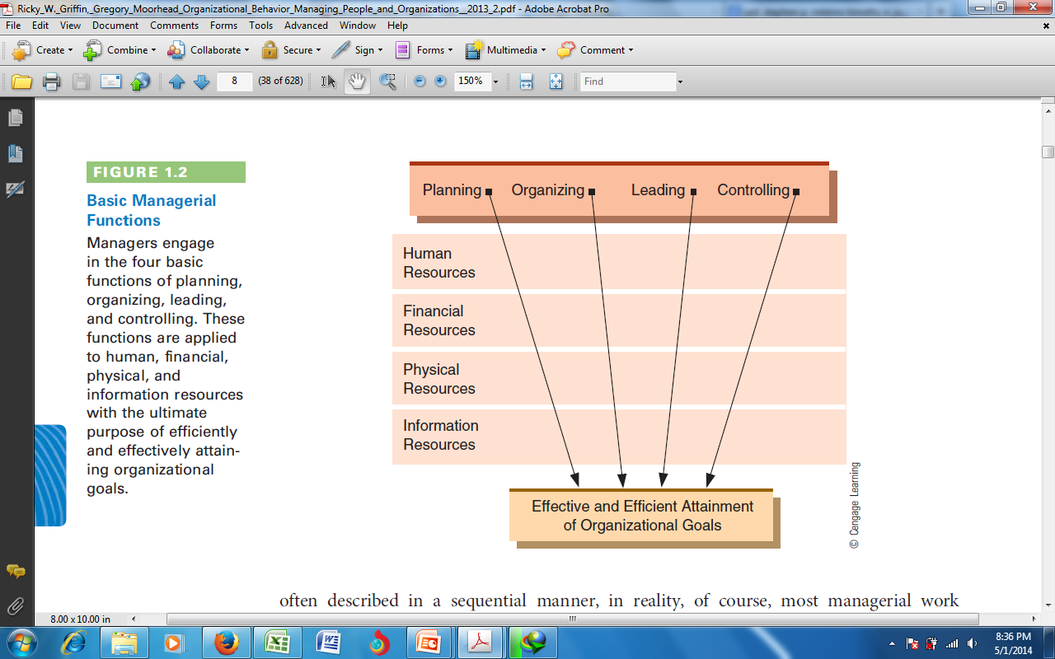
Eksistensi Informasi dalam Perspektif Manajemen
Basic Managerial Function
Griffin , R.E., Moorhead, G. (2013). Organizational Behavior Managing People and Organizations.
Cengage Learning., h.8

Slide 9
Pengertian Manajemen Perkantoran
Information Management
Office
Management
The information management or office management can thus be defined as a task of planning, coordinating, motivating the efforts of others towards the specific objectives in the office and in conformity with the over-all
objectives of the organization
[George R. Terry]
Arora, S.P. (2009). Office Organisation And Management. 2nd Edition.
Verlag Vikas Publishing House Pvt Ltd., h. 16

Slide 10
Pengertian Manajemen Perkantoran
E.C. Eyre
Office management as being concerned with providing a service of communication and records and of safeguarding assets.
Rao, M.E.T. (2000). Office Organization and Management.
New Delhi: Atlantic Publishers and Distributors, h. 16

Slide 11
Pengertian Manajemen Perkantoran
P.W. Betts
Office management as the effective application of all the managerial skills towards achieving the objectives associated with the office function of providing appropriate information and a communication network to all sectors of the organization
Rao, M.E.T. (2000). Office Organization and Management.
New Delhi: Atlantic Publishers and Distributors, h. 16

Slide 12
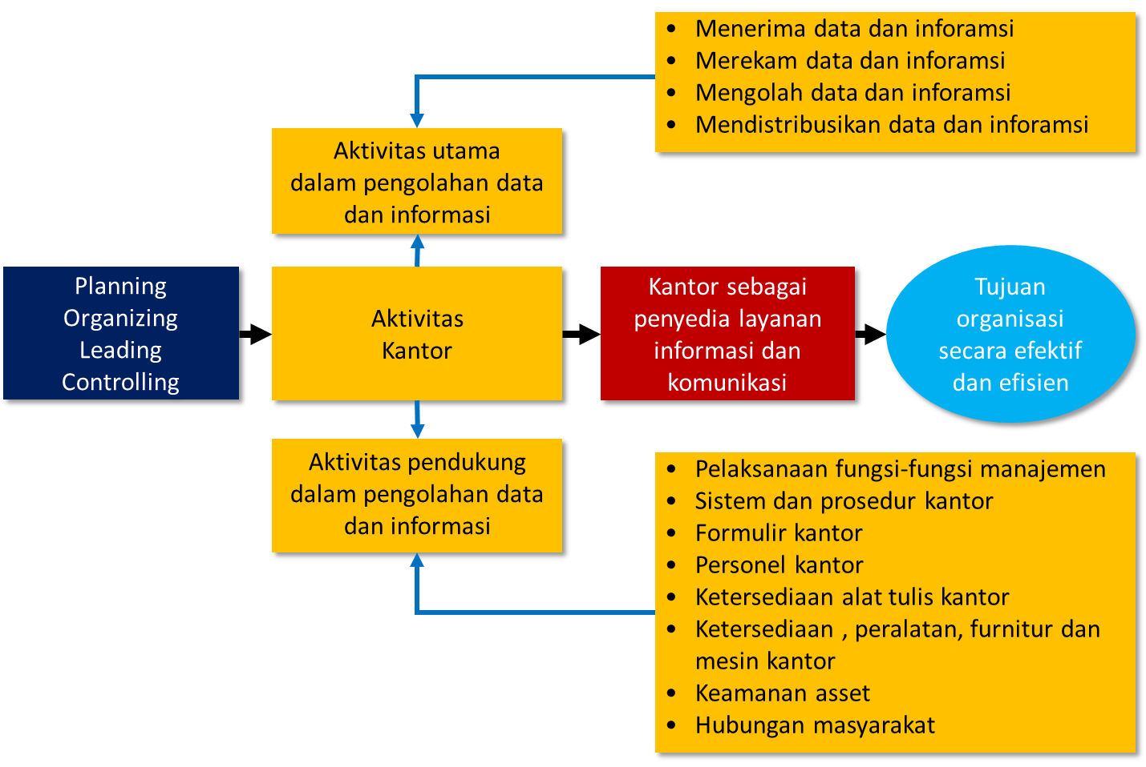
Pengertian Manajemen Perkantoran

Slide 13
Ruang Lingkup Kajian
Manajemen Perkantoran
Kausa Material
Objek studi dari suatu ilmu
Office as information and communication center
Kausa Formal
Struktur, esensi, atau pola yang terkandung dalam suatu objek studi
Office activities:
Office Information
Office Communication
Office Technology

Slide 14
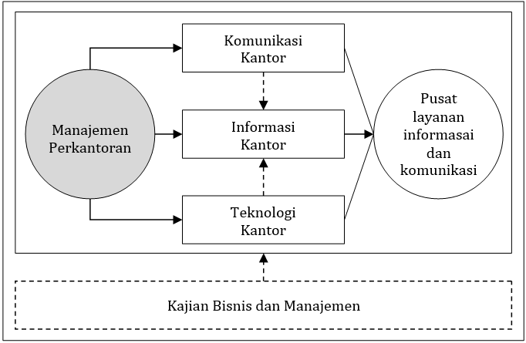
Ruang Lingkup Kajian
Manajemen Perkantoran

Slide 15
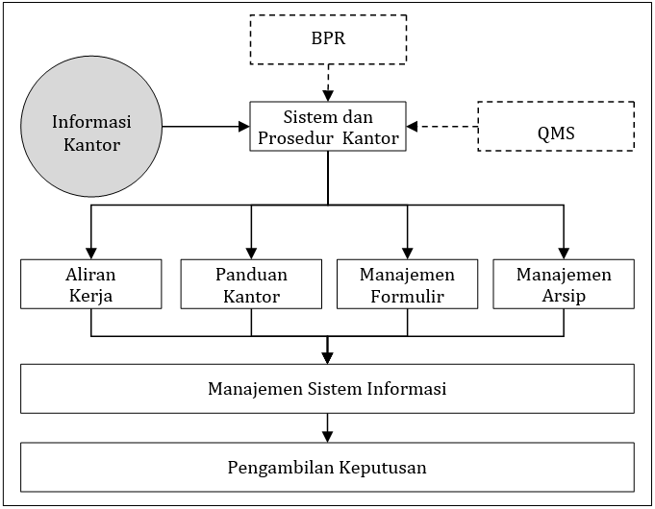
Ruang Lingkup Kajian
Manajemen Perkantoran

Slide 16
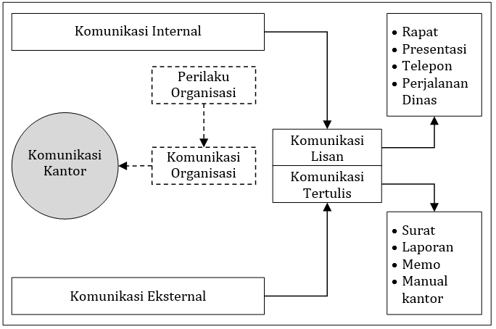
Ruang Lingkup Kajian
Manajemen Perkantoran

Slide 17
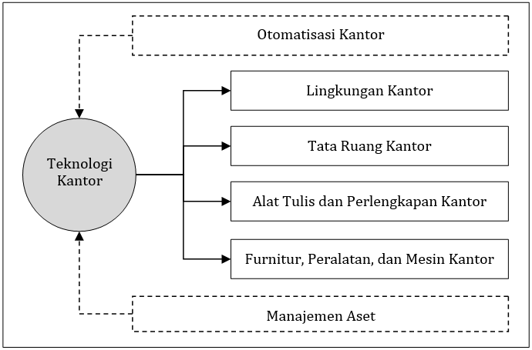
Ruang Lingkup Kajian
Manajemen Perkantoran

Slide 18
Materi – 02
Terima kasih......

