Slide 1
Uji Hipotesis
Satu Sampel
Pertemuan – 2
[ Bagian 2 ]

Slide 2
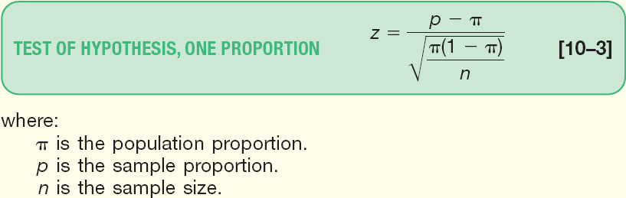
Tests Concerning Proportion
A Proportion is the fraction or percentage that indicates the part of the population or sample having a particular trait of interest.
The sample proportion is denoted by p and is found by x/n
The test statistic is computed as follows:

Slide 3
Assumptions in Testing a Population Proportion using the z-Distribution
A random sample is chosen from the population.
It is assumed that the binomial assumptions discussed in Chapter 6 are met:
(1) the sample data collected are the result of counts;
(2) the outcome of an experiment is classified into one of two mutually exclusive categories—a “success” or a “failure”;
(3) the probability of a success is the same for each trial; and (4) the trials are independent
The test we will conduct shortly is appropriate when both nπ and n(1- π ) are at least 5.
When the above conditions are met, the normal distribution can be used as an approximation to the binomial distribution

Slide 4
Test Statistic for Testing a Single Population Proportion
Hypothesized
population proportion
Sample proportion
Sample size

Slide 5
Test Statistic for Testing a Single Population Proportion - Example
Suppose prior elections in a certain state indicated it is necessary for a candidate for governor to receive at least 80 percent of the vote in the northern section of the state to be elected. The incumbent governor is interested in assessing his chances of returning to office and plans to conduct a survey of 2,000 registered voters in the northern section of the state. Using the hypothesis-testing procedure, assess the governor’s chances of reelection.

Slide 6
Test Statistic for Testing a Single Population Proportion - Example
Step 1: State the null hypothesis and the alternate hypothesis.
H₀: π ≥ .80
H₁: π < .80
(note: keyword in the problem “at least”)
Step 2: Select the level of significance.
α = 0.01 as stated in the problem
Step 3: Select the test statistic.
Use Z-distribution since the assumptions are met and nπ and n(1-π) ≥ 5

Slide 7
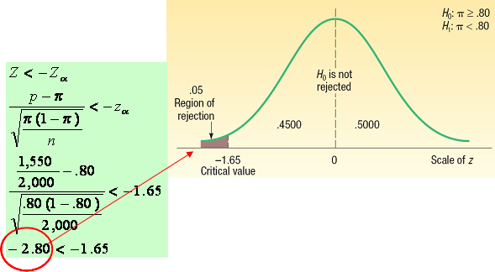
Testing for a Population Proportion - Example
Step 4: Formulate the decision rule.
Reject H₀ if Z <-Z_{α}
Step 5: Make a decision and interpret the result.
The computed value of z (2.80) is in the rejection region, so the null hypothesis is rejected at the .05 level. The difference of 2.5 percentage points between the sample percent (77.5 percent) and the hypothesized population percent (80) is statistically significant. The evidence at this point does not support the claim that the incumbent governor will return to the governor’s mansion for another four years.

Slide 8
Type II Error
Recall Type I Error, the level of significance, denoted by the Greek letter “α”, is defined as the probability of rejecting the null hypothesis when it is actually true.
Type II Error, denoted by the Greek letter “β”,is defined as the probability of “accepting” the null hypothesis when it is actually false.

Slide 9
Type II Error - Example
A manufacturer purchases steel bars to make cotter pins. Past experience indicates that the mean tensile strength of all incoming shipments is 10,000 psi and that the standard deviation, σ, is 400 psi. In order to make a decision about incoming shipments of steel bars, the manufacturer set up this rule for the quality-control inspector to follow: “Take a sample of 100 steel bars. At the .05 significance level if the sample mean strength falls between 9,922 psi and 10,078 psi, accept the lot. Otherwise the lot is to be rejected.”

Slide 10
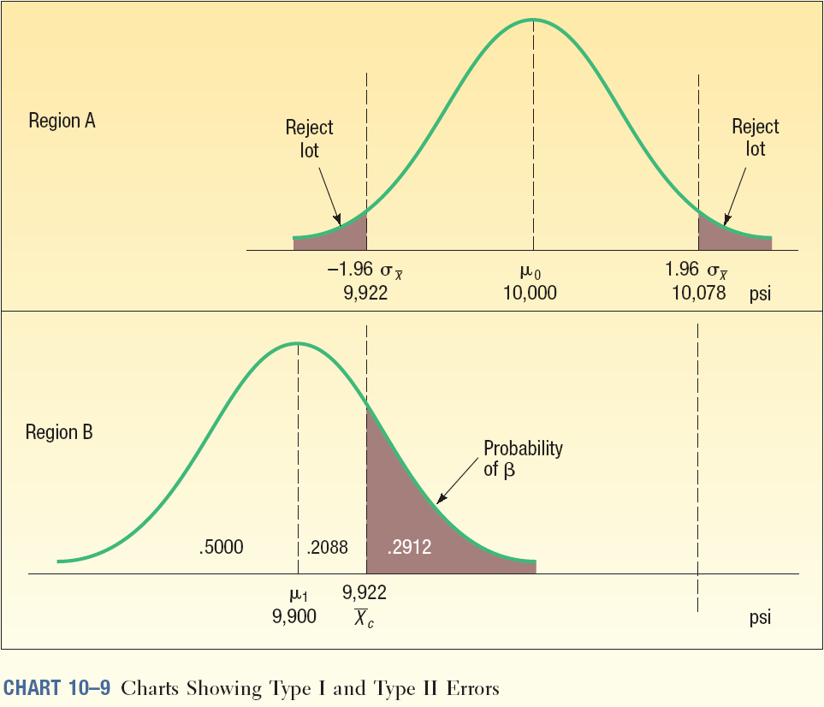
Type I and Type II Errors Illustrated

Slide 11
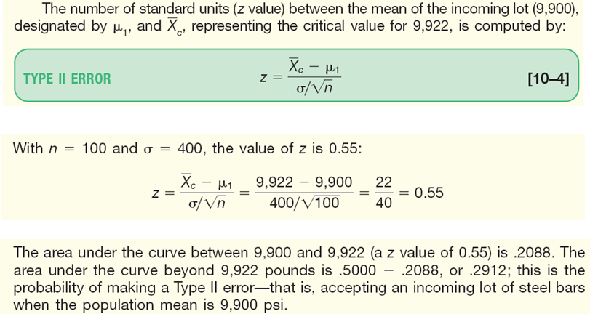
Type II Error Computed

Slide 12
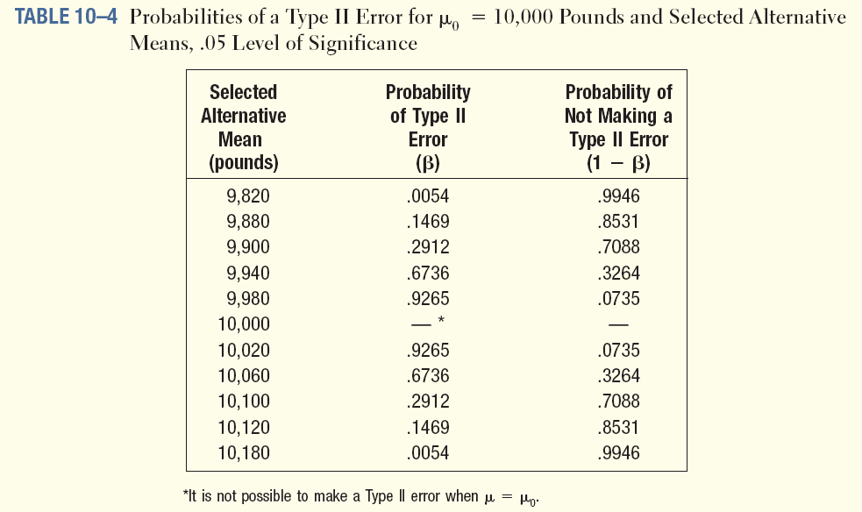
Type II Errors For Varying Mean Levels

Slide 13
Referensi
Aczel, Amir D., and Jayavel Sounderpandian (2006), Complete Business Statistics, 6th edition, McGraw Hill.
Levine, David M. (2008), Statistics for Managers : using Microsoft Excel, 5th Edition, Pearson Education.
Lind, Douglas A. (2008), Statistical Techniques in Business & Economics, 13th Edition, McGraw Hill.
Lind, Douglas A. (2007), Teknik-teknik Statistika dalam Bisnis dan Ekonomi Menggunakan Data Global, jilid 1, Edisi 13, Erlangga.
Lind, Douglas A. (2008), Teknik-teknik Statistika dalam Bisnis dan Ekonomi Menggunakan Data Global, jilid 2, Edisi 13, Erlangga.

Slide 14
Akhir materi
Pertemuan – 2

