Slide 1
Uji Hipotesis
Satu Sampel
Pertemuan – 1
[ Bagian 1 ]

Slide 2
What is a Hypothesis?
Hypothesis merupakan suatu pernyataan tentang sebuah parameter populasi yang harus diverifikasi. Contoh hipotesis tentang populasi misalnya:
  Rata-rata pendapatan per bulan seorang sistem analis adalah $3,625.
  20% dari konsumen Bovine’s Chop House kembali untuk menikmati menu lain dalam kurun satu bulan.

Slide 3
What is Hypothesis Testing?
Hypothesis testing suatu prosedur berdasarkan bukti sampel dan teori probabilitas untuk menentukan apakah suatu hipotesis merupakan pernyataan yang masuk akal.

Slide 4
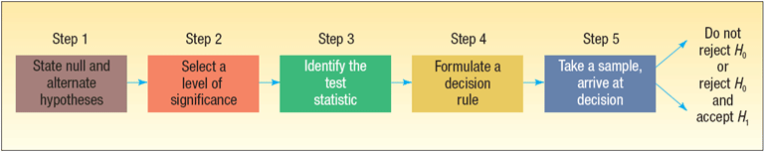
Hypothesis Testing Steps

Slide 5
Important Things to Remember about H₀ and H₁
H₀: null hypothesis and H₁: alternate hypothesis
H₀ and H₁ are mutually exclusive and collectively exhaustive
H₀ is always presumed to be true
H₁ has the burden of proof
A random sample (n) is used to “reject H₀”
If we conclude 'do not reject H₀', this does not necessarily mean that the null hypothesis is true, it only suggests that there is not sufficient evidence to reject H₀; rejecting the null hypothesis then, suggests that the alternative hypothesis may be true.
Equality is always part of H₀ (e.g. “=” , “≥” , “≤”).
“≠” “<” and “>” always part of H₁

Slide 6
How to Set Up a Claim as Hypothesis
In actual practice, the status quo is set up as H₀
If the claim is “boastful” the claim is set up as H₁ (we apply the Missouri rule – “show me”). Remember, H₁ has the burden of proof
In problem solving, look for key words and convert them into symbols. Some key words include: “improved, better than, as effective as, different from, has changed, etc.”

Slide 7
Left-tail or Right-tail Test?
The direction of the test involving claims that use the words “has improved”, “is better than”, and the like will depend upon the variable being measured.
For instance, if the variable involves time for a certain medication to take effect, the words “better” “improve” or more effective” are translated as “<” (less than, i.e. faster relief).
On the other hand, if the variable refers to a test score, then the words “better” “improve” or more effective” are translated as “>” (greater than, i.e. higher test scores)
Keywords | Inequality Symbol | Part of:
Larger (or more) than | > | H₁
Smaller (or less) | < | H₁
No more than | ≤ | H₀
At least | ≥ | H₀
Has increased | > | H₁
Is there difference? | ≠ | H₁
Has not changed | = | H₀
Has “improved”, “is better than”. “is more effective” | See right | H₁

Slide 8
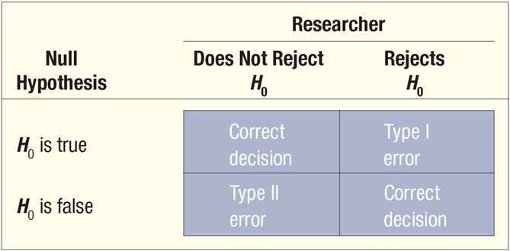

Slide 9
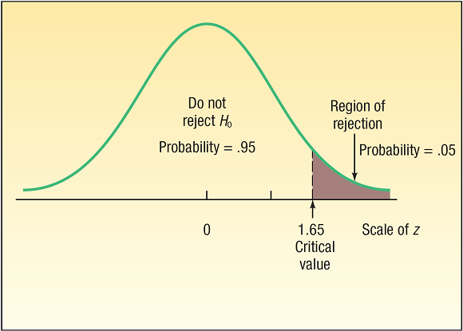
Parts of a Distribution in Hypothesis Testing

Slide 10
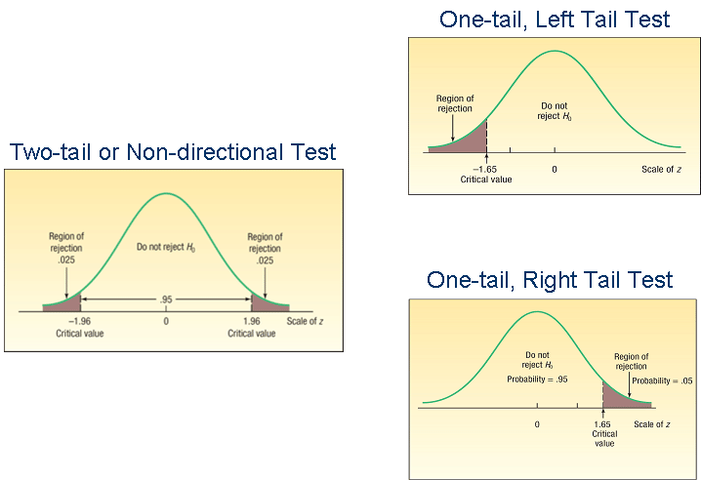
One-tail vs. Two-tail Test

Slide 11
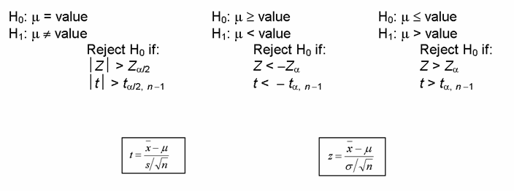
Hypothesis Setups for Testing a Mean (μ)

Slide 12
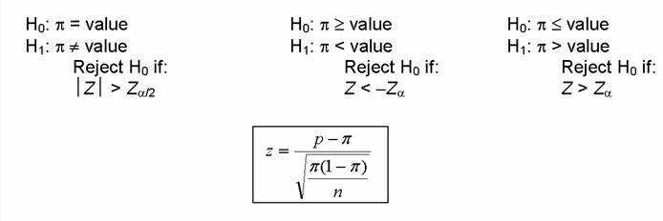
Hypothesis Setups for Testing a Proportion (π)

Slide 13

Testing for a Population Mean with a
Known Population Standard Deviation- Example
Jamestown Steel Company manufactures and assembles desks and other office equipment at several plants in western New York State. The weekly production of the Model A325 desk at the Fredonia Plant follows the normal probability distribution with a mean of 200 and a standard deviation of 16. Recently, because of market expansion, new production methods have been introduced and new employees hired. The vice president of manufacturing would like to investigate whether there has been a change in the weekly production of the Model A325 desk.

Slide 14
Testing for a Population Mean with a
Known Population Standard Deviation- Example
Step 1: State the null hypothesis and the alternate hypothesis.
H₀: μ = 200
H₁: μ ≠ 200
(note: keyword in the problem “has changed”)
Step 2: Select the level of significance.
α = 0.01 as stated in the problem
Step 3: Select the test statistic.
Use Z-distribution since σ is known

Slide 15
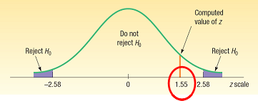
Testing for a Population Mean with a
Known Population Standard Deviation- Example
Step 4: Formulate the decision rule.
Reject H₀ if |Z| > Z_{α/2}
Step 5: Make a decision and interpret the result.
Because 1.55 does not fall in the rejection region, H₀ is not rejected. We conclude that the population mean is not different from 200. So we would report to the vice president of manufacturing that the sample evidence does not show that the production rate at the Fredonia Plant has changed from 200 per week.

Slide 16
Testing for a Population Mean with a Known Population Standard Deviation- Another Example
Suppose in the previous problem the vice president wants to know whether there has been an increase in the number of units assembled. To put it another way, can we conclude, because of the improved production methods, that the mean number of desks assembled in the last 50 weeks was more than 200?
Recall: σ=16, n=200, α=.01

Slide 17
Testing for a Population Mean with a Known Population Standard Deviation- Example
Step 1: State the null hypothesis and the alternate hypothesis.
H₀: μ ≤ 200
H₁: μ > 200
(note: keyword in the problem “an increase”)
Step 2: Select the level of significance.
α = 0.01 as stated in the problem
Step 3: Select the test statistic.
Use Z-distribution since σ is known

Slide 18
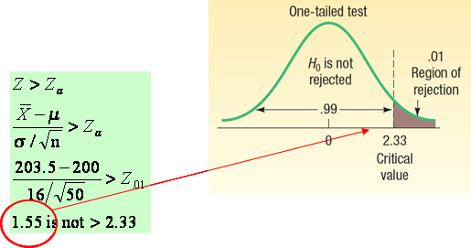
Testing for a Population Mean with a Known Population Standard Deviation- Example
Step 4: Formulate the decision rule.
Reject H₀ if Z > Z_{α}
Step 5: Make a decision and interpret the result.
Because 1.55 does not fall in the rejection region, H₀ is not rejected. We conclude that the average number of desks assembled in the last 50 weeks is not more than 200

Slide 19
Type of Errors in Hypothesis Testing
Type I Error -
  Defined as the probability of rejecting the null hypothesis when it is actually true.
  This is denoted by the Greek letter “α”
  Also known as the significance level of a test
Type II Error:
  Defined as the probability of “accepting” the null hypothesis when it is actually false.
  This is denoted by the Greek letter “β”

Slide 20
p-Value in Hypothesis Testing
p-VALUE is the probability of observing a sample value as extreme as, or more extreme than, the value observed, given that the null hypothesis is true.
In testing a hypothesis, we can also compare the p-value to with the significance level (α).
If the p-value < significance level, H₀ is rejected, else H₀ is not rejected.

Slide 21
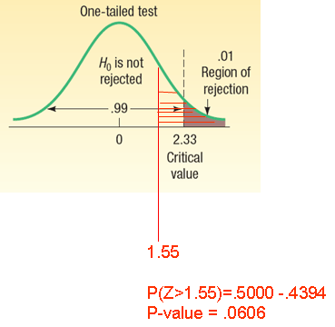
p-Value in Hypothesis Testing - Example
Recall the last problem where the hypothesis and decision rules were set up as:
H₀: μ ≤ 200
H₁: μ > 200
Reject H₀ if Z > Z_{α}
where Z = 1.55 and Z_{α} =2.33
Reject H₀ if p-value < α
0.0606 is not < 0.01
Conclude: Fail to reject H₀

Slide 22
What does it mean when p-value < α?
(a) .10, we have some evidence that H₀ is not true.
(b) .05, we have strong evidence that H₀ is not true.
(c) .01, we have very strong evidence that H₀ is not true.
(d) .001, we have extremely strong evidence that H₀ is not true.

Slide 23
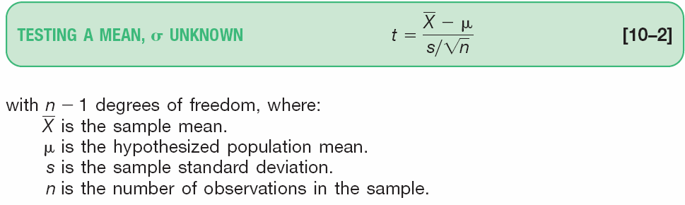
Testing for the Population Mean: Population Standard Deviation Unknown
When the population standard deviation (σ) is unknown, the sample standard deviation (s) is used in its place
The t-distribution is used as test statistic, which is computed using the formula:

Slide 24
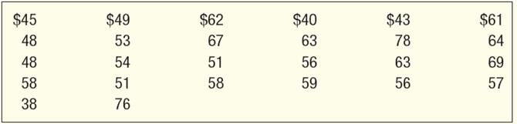
Testing for the Population Mean: Population Standard Deviation Unknown - Example
The McFarland Insurance Company Claims Department reports the mean cost to process a claim is $60. An industry comparison showed this amount to be larger than most other insurance companies, so the company instituted cost-cutting measures. To evaluate the effect of the cost-cutting measures, the Supervisor of the Claims Department selected a random sample of 26 claims processed last month. The sample information is reported below.
At the .01 significance level is it reasonable a claim is now less than $60?

Slide 25
Testing for a Population Mean with a
Known Population Standard Deviation- Example
Step 1: State the null hypothesis and the alternate hypothesis.
H₀: μ ≥ $60
H₁: μ < $60
(note: keyword in the problem “now less than”)
Step 2: Select the level of significance.
α = 0.01 as stated in the problem
Step 3: Select the test statistic.
Use t-distribution since σ is unknown

Slide 26
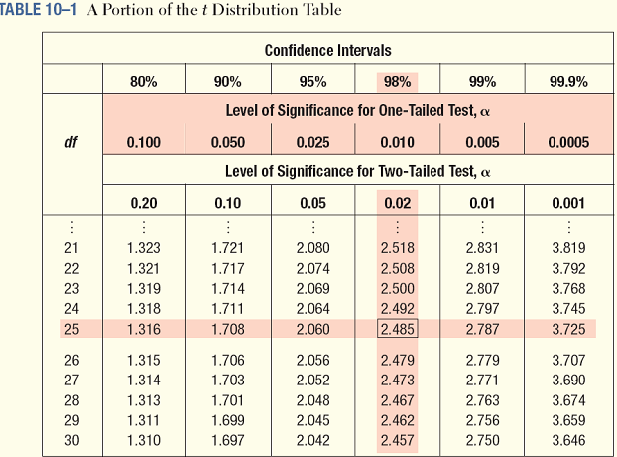
t-Distribution Table (portion)

Slide 27
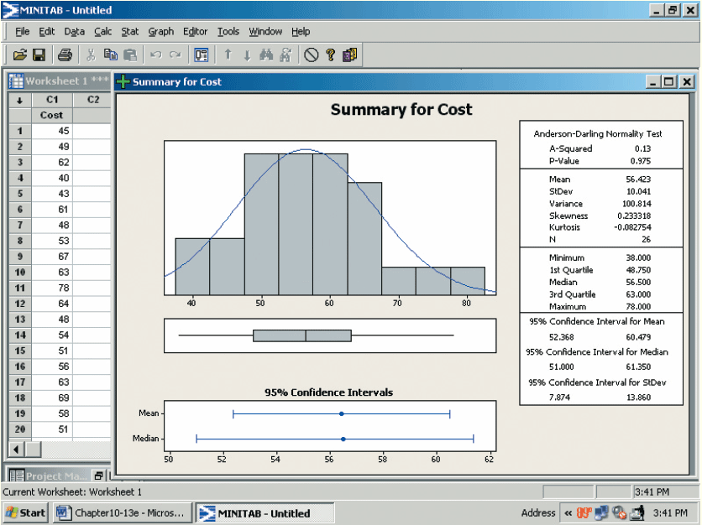
Testing for the Population Mean: Population Standard Deviation Unknown – Minitab Solution

Slide 28
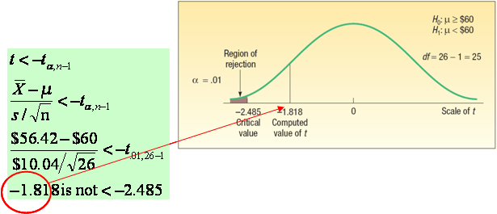
Testing for a Population Mean with a
Known Population Standard Deviation- Example
Step 4: Formulate the decision rule.
Reject H₀ if t < -t_{α,n-1}
Step 5: Make a decision and interpret the result.
Because -1.818 does not fall in the rejection region, H₀ is not rejected at the .01 significance level. We have not demonstrated that the cost-cutting measures reduced the mean cost per claim to less than $60. The difference of $3.58 ($56.42 - $60) between the sample mean and the population mean could be due to sampling error.

Slide 29
Testing for a Population Mean with an Unknown Population Standard Deviation- Example
The current rate for producing 5 amp fuses at Neary Electric Co. is 250 per hour. A new machine has been purchased and installed that, according to the supplier, will increase the production rate. A sample of 10 randomly selected hours from last month revealed the mean hourly production on the new machine was 256 units, with a sample standard deviation of 6 per hour.
At the .05 significance level can Neary conclude that the new machine is faster?

Slide 30
Testing for a Population Mean with a
Known Population Standard Deviation- Example continued
Step 1: State the null and the alternate hypothesis.
H₀: µ ≤ 250; H₁: µ > 250
Step 2: Select the level of significance.
It is .05.
Step 3: Find a test statistic. Use the t distribution because the population standard deviation is not known and the sample size is less than 30.

Slide 31
Testing for a Population Mean with a
Known Population Standard Deviation- Example continued
Step 4: State the decision rule.
There are 10 – 1 = 9 degrees of freedom. The null hypothesis is rejected if t > 1.833.
Step 5: Make a decision and interpret the results.
The null hypothesis is rejected. The mean number produced is more than 250 per hour.

Slide 32
Referensi
Aczel, Amir D., and Jayavel Sounderpandian (2006), Complete Business Statistics, 6th edition, McGraw Hill.
Levine, David M. (2008), Statistics for Managers : using Microsoft Excel, 5th Edition, Pearson Education.
Lind, Douglas A. (2008), Statistical Techniques in Business & Economics, 13th Edition, McGraw Hill.
Lind, Douglas A. (2007), Teknik-teknik Statistika dalam Bisnis dan Ekonomi Menggunakan Data Global, jilid 1, Edisi 13, Erlangga.
Lind, Douglas A. (2008), Teknik-teknik Statistika dalam Bisnis dan Ekonomi Menggunakan Data Global, jilid 2, Edisi 13, Erlangga.

Slide 33
Akhir materi
Pertemuan – 1

