Slide 1
Ukuran Perbandingan
[Angka Indeks]
Pertemuan - 6

Slide 2
Index Numbers
An index number measures the relative change in price, quantity, value, or some other item of interest from one time period to another.
A simple index number measures the relative change in just one variable.

Slide 3
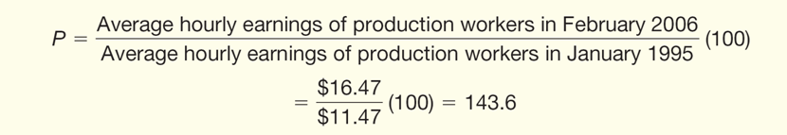
Index Number – Example 1
According to the Bureau of Labor Statistics, in January 1995 the average hourly earnings of production workers was $11.47. In June 2005 it was $16.07.
What is the index of hourly earnings of production workers for June 2005 based on January 1995?

Slide 4
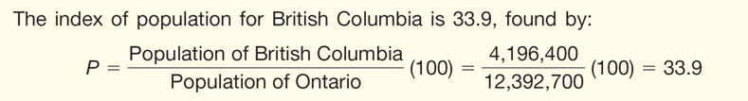
Index Number –Example 2
An index can also compare one item with another.
Example: The population of the Canadian province of British Columbia in 2004 was 4,196,400 and for Ontario it was 12,392,700. What is the population index of British Columbia compared to Ontario?

Slide 5
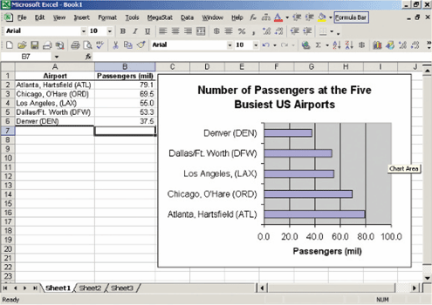
Index Number – Example 3
The following Excel output shows the number of passengers (in millions) for the five largest airports in the United States in 2004.
What is the index for Atlanta, Chicago, Los Angeles, and Dallas/Ft. Worth compared to Denver?

Slide 6
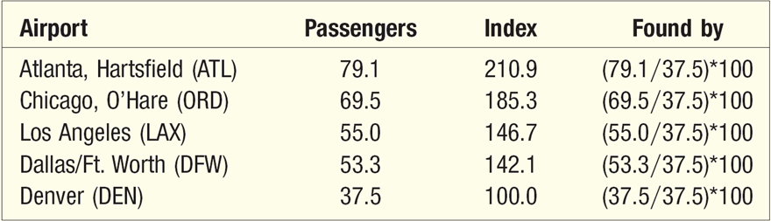
Index Number – Example 3 (cont.)

Slide 7
Why Convert Data to Indexes?
An index is a convenient way to express a change in a diverse group of items.
  The Consumer Price Index (CPI), for example, encompasses about 400 items—including golf balls, lawn mowers, hamburgers, funeral services, and dentists’ fees. Prices are expressed in dollars per pound, box, yard, and many other different units. Only by converting the prices of these many diverse goods and services to one index number can the federal government and others concerned with inflation keep informed of the overall movement of consumer prices.
Converting data to indexes also makes it easier to assess the trend in a series composed of exceptionally large numbers.
  For example, total U.S. retail sales for the month of July 2005 were $357,013,000. For July 2004, the total retail sales were $323,604,000. This increase of $33,409,000 appears significant. Yet if the July 2005 retail sales are expressed as an index based on July 2004 retail sales the increase is 10.3 percent.

Slide 8
Indexes
In many situations we wish to combine several items and develop an index to compare the cost of this aggregation of items in two different time periods.
      For example, we might be interested in an index for items that relate to the expense of operating and maintaining an automobile. The items in the index might include tires, oil changes, and gasoline prices.
      Or we might be interested in a college student index. This index might include the cost of books, tuition, housing, meals, and entertainment.
There are several ways we can combine the items to determine the index.

Slide 9
Indexes
Unweighted Indexes
  Simple Average of the Price Indexes
  Simple Aggregate Index
Weighted Indexes
  Lespeyres Price Index
  Paasche Price Index
Fisher’s Price Index
Value Index
Special Purpose Index
  Consumer Price Index
  Producer Price Index
  S&P Index

Slide 10
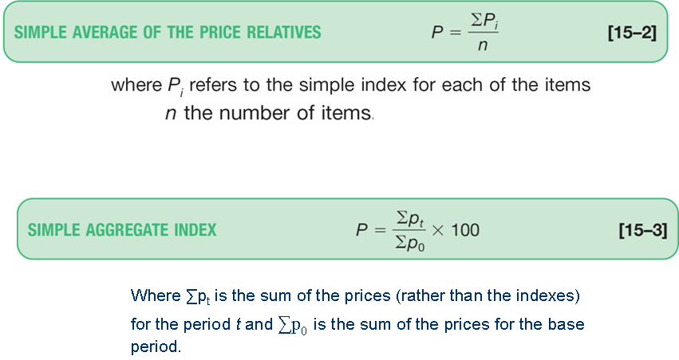
Unweighted Indexes

Slide 11
Laspeyres versus Paasche Index
When is Laspeyres most appropriate and when is Paasche the better choice?
Laspeyres
  Advantages Requires quantity data from only the base period. This allows a more meaningful comparison over time. The changes in the index can be attributed to changes in the price.
  Disadvantages Does not reflect changes in buying patterns over time. Also, it may overweight goods whose prices increase.
Paasche
  Advantages Because it uses quantities from the current period, it reflects current buying habits.
  Disadvantages It requires quantity data for the current year. Because different quantities are used each year, it is impossible to attribute changes in the index to changes in price alone. It tends to overweight the goods whose prices have declined. It requires the prices to be recomputed each year.

Slide 12
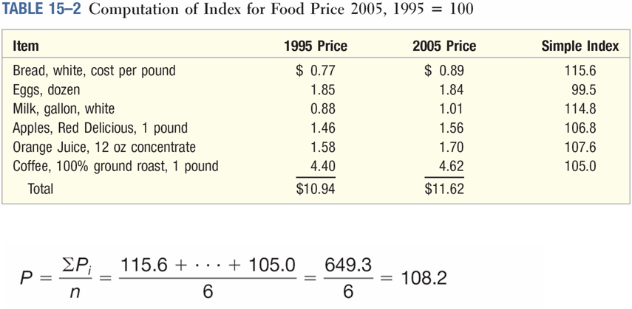
Simple Average - Example

Slide 13
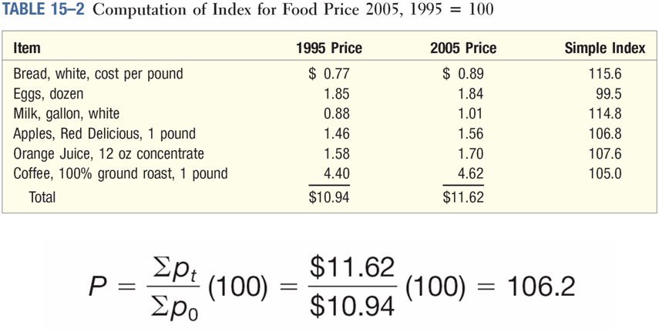
Simple Aggregate Index – Example

Slide 14
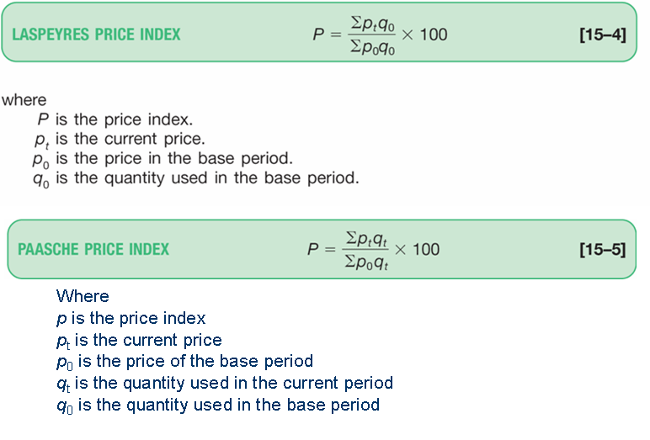
Weighted Indexes

Slide 15
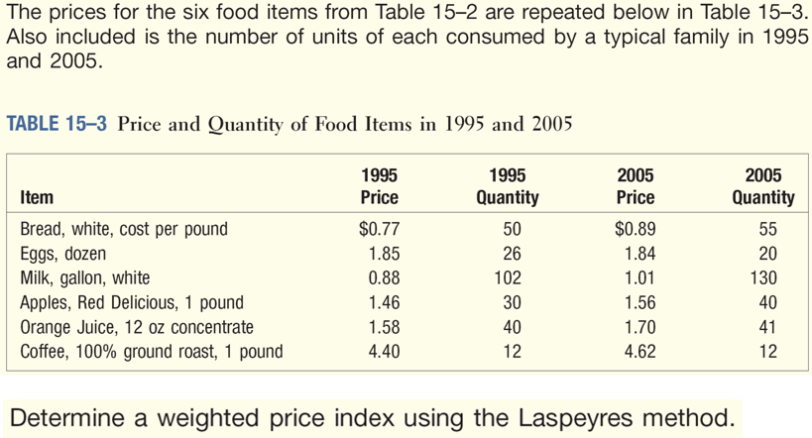
Lespeyres Index - Example

Slide 16
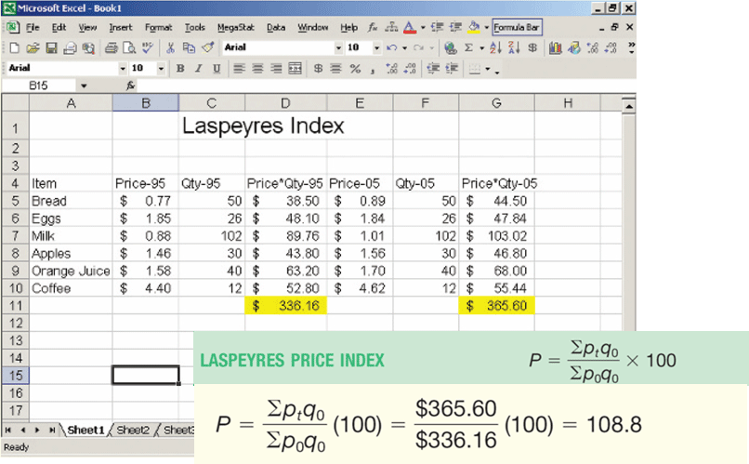
Lespeyres Index - Example
p₀
q₀
p₀q₀
p_{t}
q₀
p_{t}q₀

Slide 17
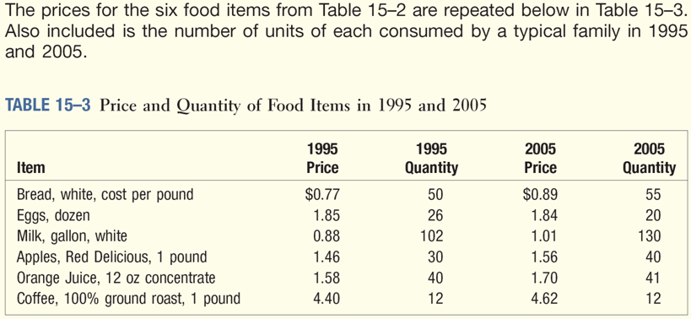
Paasche Index - Example

Slide 18
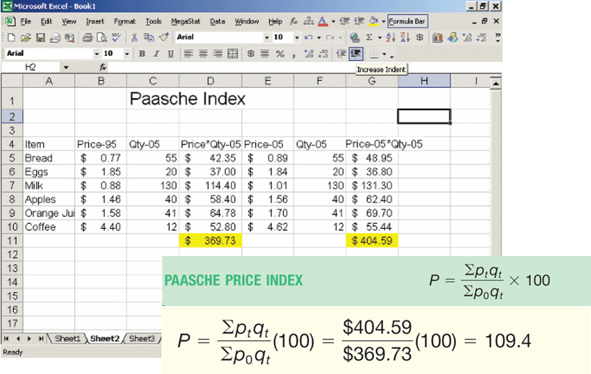
Paasche Index - Example
p₀
q_{t}
p₀q_{t}
p_{t}
q_{t}
p_{t}q_{t}

Slide 19
Fisher’s Ideal Index
Laspeyres’ index tends to overweight goods whose prices have increased. Paasche’s index, on the other hand, tends to overweight goods whose prices have gone down.
Fisher’s ideal index was developed in an attempt to offset these shortcomings.
It is the geometric mean of the Laspeyres and Paasche indexes.

Slide 20
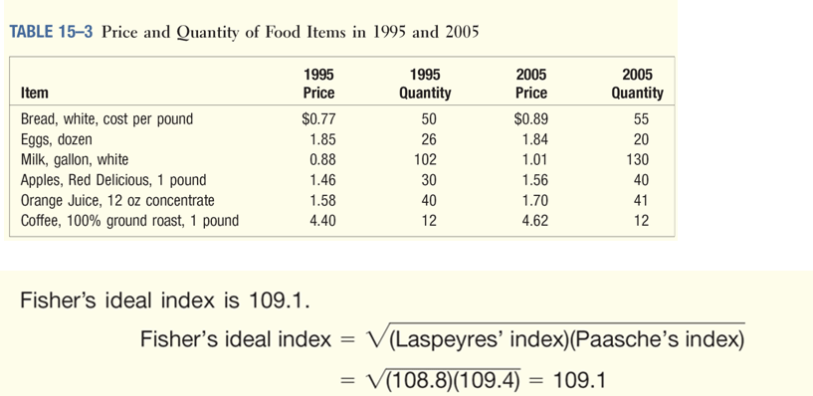
Fisher’s Ideal Index - Example
Determine Fisher’s ideal index for the data in Table 15–3.

Slide 21
Value Index
A value index measures changes in both the price and quantities involved.
A value index, such as the index of department store sales, needs the original base-year prices, the original base-year quantities, the present-year prices, and the present year quantities for its construction.
Its formula is:

Slide 22
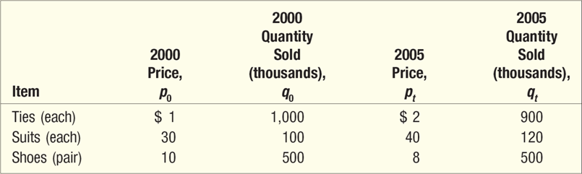
Value Index - Example
The prices and quantities sold at the Waleska Clothing Emporium for various items of apparel for May 2000 and May 2005 are:
What is the index of value for May 2005 using May 2000 as the base period?

Slide 23
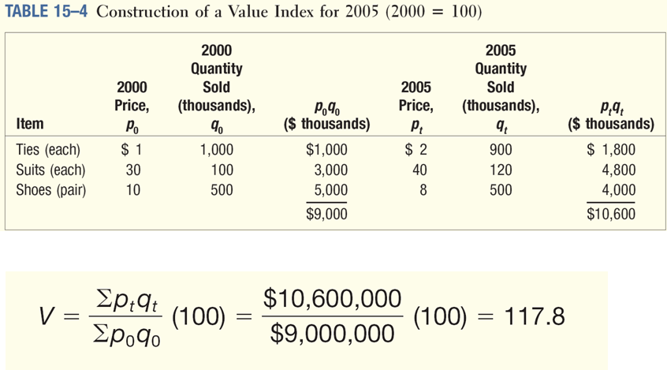
Value Index - Example

Slide 24
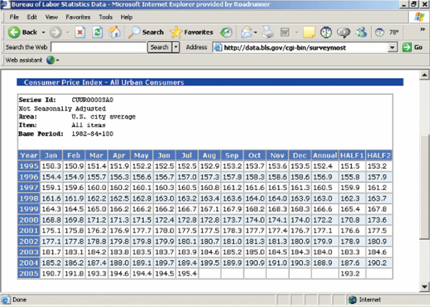
Consumer Price Index
The U.S. Bureau of Labor Statistics reports this index monthly. It describes the changes in prices from one period to another for a “market basket” of goods and services.

Slide 25
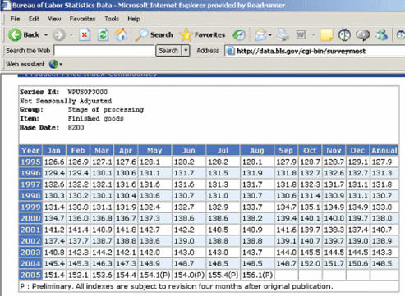
Producers Price Index
Formerly called the Wholesale Price Index, it dates back to 1890 and is also published by the U.S. Bureau of Labor Statistics.
It reflects the prices of over 3,400 commodities. Price data are collected from the sellers of the commodities, and it usually refers to the first large-volume transaction for each commodity. It is a Laspeyres-type index.

Slide 26

Dow Jones Industrial Average (DJIA)
DJIA is an index of stock prices, but perhaps it would be better to say it is an “indicator” rather than an index.
It is supposed to be the mean price of 30 specific industrial stocks.
However, summing the 30 stock prices and dividing by 30 does not calculate its value. This is because of stock splits, mergers, and stocks being added or dropped.
When changes occur, adjustments are made in the denominator used with the average.

Slide 27
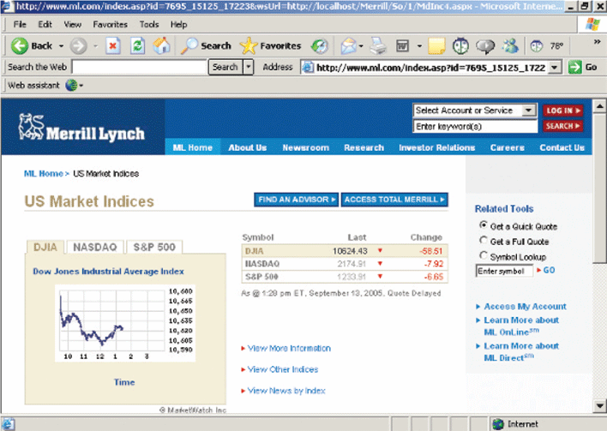

Slide 28
CPI Uses
It allows consumers to determine the effect of price increases on their purchasing power.
It is a yardstick for revising wages, pensions, alimony payments, etc.
It is an economic indicator of the rate of inflation in the United States.
It computes real income:
real income = money income/CPI X (100)

Slide 29
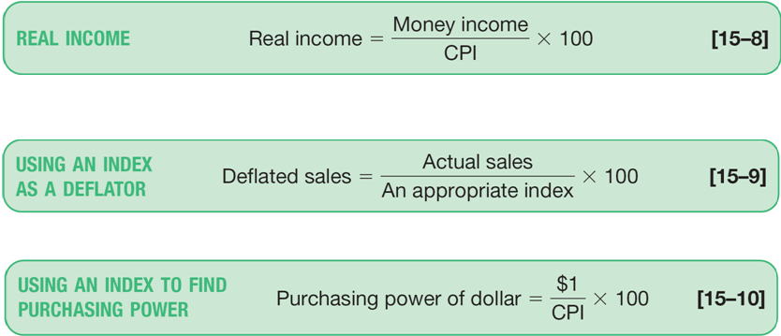
CPI Uses - Formulas

Slide 30
Referensi
Aczel, Amir D., and Jayavel Sounderpandian (2006), Complete Business Statistics, 6th edition, McGraw Hill.
Levine, David M. (2008), Statistics for Managers : using Microsoft Excel, 5th Edition, Pearson Education.
Lind, Douglas A. (2008), Statistical Techniques in Business & Economics, 13th Edition, McGraw Hill.
Lind, Douglas A. (2007), Teknik-teknik Statistika dalam Bisnis dan Ekonomi Menggunakan Data Global, jilid 1, Edisi 13, Erlangga.
Lind, Douglas A. (2008), Teknik-teknik Statistika dalam Bisnis dan Ekonomi Menggunakan Data Global, jilid 2, Edisi 13, Erlangga.
Wahab, Moataza Mahmoud Abdel, Sampling Techniques & Sample Size, Presentation Material of Biostatistic, High Institute of Public Health, University of Alexandria.

Slide 31
Akhir materi
Pertemuan - 6

