Slide 1
Scanning

Slide 2
What is scanning?
Scanning is very fast reading to find specific information
When you scan, do not read every word. Focus on the key word and the specific information you want to find

Slide 3
Scanning in everyday life
Reading the list of TV programs
Finding information on train schedule
Knowing what movies are shown
Scanning for specific information on newspaper/magazine
Deciding the menu in a restaurant
Reading the advertisement
Looking up the words in a dictionary
Etc.

Slide 4
Exercise 1:
Look at the table, and find out:
Which product is the most expensive?
Which one is the cheapest?
What products have the same price?

Slide 5
Table 1
Product | Price
Umbrella | 40.000
Jacket | 150.000
Rug | 25.000
Wallet | 40.000

Slide 6
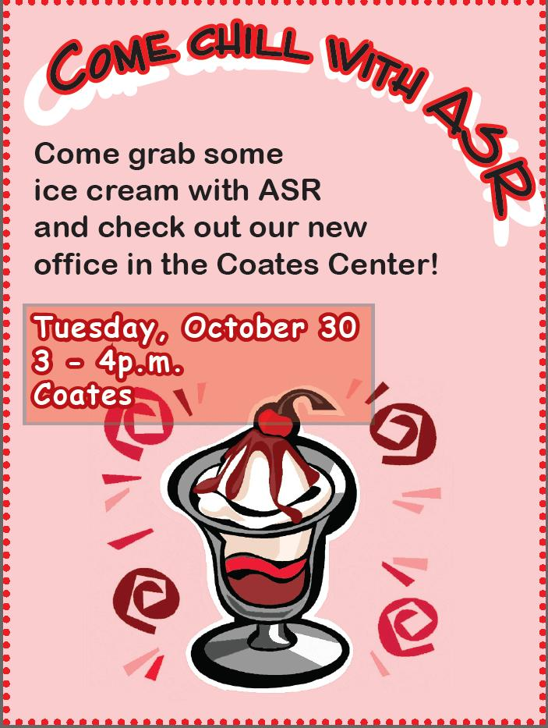
Exercise 2: Look at this ads. When will the event be held?

