Slide 1
INTELLIGENCE & MOTIVATION
Oleh:
Eka Sakti Yudha

Slide 2
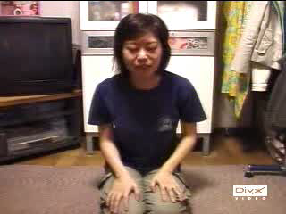

Slide 3
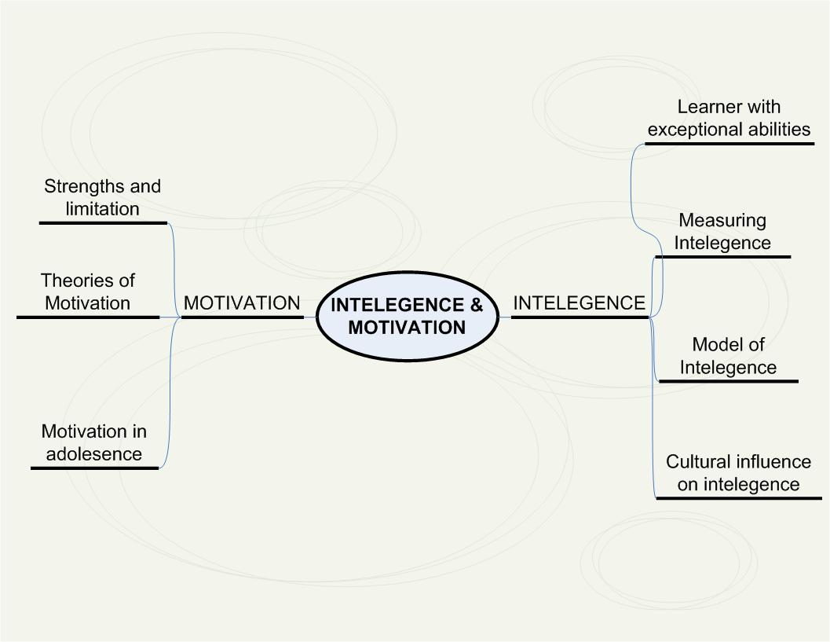

Slide 4
What is Intelligence
Western: Mental agility/ mental speed.
Pacific island: skill of navigation (the ability to read waves, clouds & stars)
Luo People:
Rieko (smartness, knowledge, ability, competences & power)
Luoro is social qualities (respect & care for other, obedience, deligent)
Paro is the thinking involved in problem solving
Winjo is comprehending and understanding

Slide 5
Models of Intelligence
Spearman and ‘g’
Thrustone and Primary mental abilities
Guilford’s structure of intelect model
Gardner’s theory of multiple intelegence
Stenberg’s triarchic model of intelligence

Slide 6
1. Spearman and “g”
Charles Spearman (1904-1927) adalah seorang psikolog di Inggris.
General abilities “g” merujuk pada kecepatan/ efisiensi otak memproses informasi/ stimulus. (all intellectual tasks and mental abilities)
Specific mental abilities “s” adalah kecakapan khusus yang dimuliki secara unik oleh masing-masing individu

Slide 7
2. Thurstone & PMA
In 1938 American psychologist Louis L. Thurstone proposed that intelligence was not one general factor, but a small set of independent factors of equal importance.
He called these factor Primary Mental Ability (PMA)
Thrustone & Thelma devised a set of 56 tests
7 Abilities: numerical, verbal comprehension, word fluency, space, reasoning, memory & possibly perceptual speed.

Slide 8
3. Guilford’s structure of intellect model
Guilford menolah konsep “g” dan PMA kemudian ia menyusun 3 dimensi dasar
The processes or mental operation performed (thinking, evaluating, recalling)
The content or the kind of stimulus material that is involved (words or symbols, picture, sound, feeling & action
The form of the product being processed (relationship, units, classes, system and implication)

Slide 9
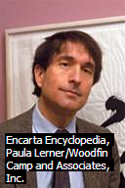
4. Gardner’s of theory of Multiple Intelegence
Howard Gardner adalah seorang psikolog Amerika
Ia menolak tes intelegensi tradisional karena tes-tes tersebut terlalu didominasi ide-ide “barat”
Gardner (1983) memformulasikan 8 area intelegensi: Linguistik, Musical, Logis matematis, Spasial, Bodily kinestetic, Intrapersonal, Interpersonal, Naturalis

Slide 10
Area of Intelegence | Description | Example of Ocupation
1. Linguistic | Ability to perceive or generate spoken and written language | Poet, Lawyer, Writer
2. Musical | Sensitivity to pitch, rhythm and timbre | Musician, Music critic
3. Logical Mathematical | Use and appreciation of numerical, causal, abstract or logical relation | Mathematician, Scientist, Engineer
4. Spatial | Ability to perceive visual and spatial information | Navigator, Visual artist
5. Bodily Kinesthetic | Control of all or parts of one’s body to solve problem or create product | Dancer, Athlete, Hiker
6. Intrapersonal | Capacity to form a mental model of oneself and use the model to make informed decision about possible actions | Psychologist, Psychoanalist
7. Interpersonal | Capacity to recognize, distinguish between and influence in desire ways others feelings, believe and intensions | Religious leader, Politician
8. Naturalist | Ability to understand and work effectively in natural world | Biologist, zoologist, naturalist

Slide 11
Stenberg’s Triarchic model of intelligence
Triarchic model of intelligence:
Analytic, the mental aspect of an individual’s cognitive activity as in information processing skill and metacognition
Creative, an individual’s ability to respond to event in the light of previous experience.
Practical. How an individual copes with everyday environment

Slide 12
Implikasinya bagi Pendidik
Kurikulum di sekolah lebih luas cakupannya agar dapat memfasilitasi minat dan bakat siswa (mis.ekskul)
Melakukan diagnosa awal terhadap peserta didik agar dapat memberikan bimbingan sesuai dengan intelgensinya.
Pendidik hendaknya waspada terhadap siswa yang memiliki bakat khusus, serta berupaya untuk mengoptimalkannya

Slide 13
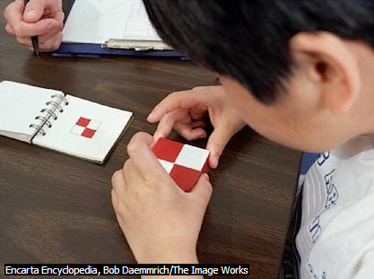
Measuring Intelligence

Slide 14
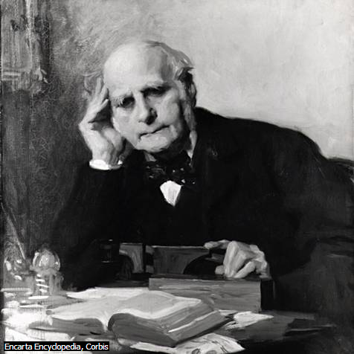
          Interest in measuring individual differences in mental ability began in the late 19th century. Sir Frances Galton
          He tried to relate intellectual ability to skills such as reaction time, sensitivity to physical stimuli, and body proportions. For example, he measured the highest and lowest pitch a person could hear and how well a person could detect minute differences between weights, colors, smells, and other physical stimuli.

Slide 15
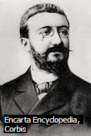

        Alfred Binet & Theodore Simon a prominent French psychologist, was the first to develop an intelligence test that accurately predicted academic success.
        Binet & Simon developed 30 items that measured practical and skill.
        Test item required children to name object in picture, define world, repeat a set of digits, copy a simple shape, tell the time on an analog clock.

Slide 16
Contoh tes intelegensi Binet-Simon
Age | TAsk
3 tahun | Menunjukkan mata, hidung & mulut Menyebutkan benda di gambar Menyebutkan nama anggota keluarga Mengulang kata-kata sederhana
4 tahun | Menyadari jenis kelaminnya Membedakan antara kunci, pisau dan uang Membandingkan panjang dua garis berbeda
5 tahun | Membandingkan berat dua benda yang berbeda Menyalin bentuk persegi Menghitung jumlah 4 koin uang
15 tahun | Membuat 3 sajak Menginterpretasikan gambar Menyelesaikan masalah dari problem set

Slide 17
Wechsler’s intelligence scales
In 1939, David Wechsler proposes a solution to the problem of calculating adult IQ’s.
WAIS- Wechsler Adult Intelligent Scale
WEISC-III- Wechsler Intelligence Scale for Children version III
WPPSI-III, Wechsler Preschool and Primary Scale of Intelligence.

Slide 18
Strengths & Limitations of Intelligence test
Kekuatan: dapat memberikan layanan pendidikan yang tepat bagi peserta didik (underachieving, gifted)
Keterbatasan: berhubungan dengn validitas dan reliabilitas sebuah alat tes, dan hasil tes tersebut dijadikan rujukan pengambilan keputusan

Slide 19
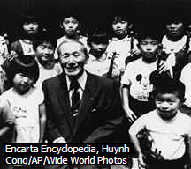
Peserta Didik dengan Kemampuan Khusus

Slide 20
Konsep gifted, talent & creativity
Gifted, merujuk pada individu yang memiliki IQ yang tinggi
Talent, merujuk pada individu yang memiliki performance superior pada satu bidang atau lebih
Creativity, merujuk pada individu yang berpikir secara inovatif atau valuable idea.

Slide 21
Karakteristik khusus
Language and literacy related skill, memiliki perbendaharaan kata yang kaya, kemampuan dalam mendiskusikan konsep yang kompleks, dan menguasai beberapa bahasa
Cognitive and problem solving skill, kecepatan menguasai dan memanggil informasi, bekerja mandiri, perfectionist, mampu mengaplikasikan ilmu dalam berbagai setting.
Independence and broad interest and activities, inisiatif, minatnya luas dalam art, musik &drama mampu membina hubungan yang baik dengan orang yang lebih tua

Slide 22
Bagaimana mengidentifikasi anak berbakat?
Observasi di Kelas
Informasi dari orang tua, peer group, tugas individual
Formal assesment
  Achievment test
  Tes intelegensi
  Tes kreativitas

Slide 23
Educational Program for Gifted students
Program akselerasi dengan kurikulum yang berbeda
Pengayaan | Extension | Akselerai
Memberikan kesempatan yang lebih luas kepada siswa untuk belajar | Mendorong tercapainya kurikulum di atas standar | Memberikan kesempatan untuk bergabung dengan siswa yang berada pada level yang lebih tinggi
Wisata Akademik Kompetisi kelas Debat dan public speaking Menggunakan ICT | Peer teaching Program paralel Learning centre Use ICT/ virtual instruction | pencapaian waktu belajar yang lebih cepat menggabungkan siswa yang berbakat pada kelas yang sama

Slide 24
Strengths and Limitations Program
Strengths
Peserta didik terfasilitasi dengan bakat khusus yang dimilikinya, karena jika tidak mungkin siswa mengalami under achievement dan gagal studi
Limitations
Exclusive class memungkinkan siswa menjadi terisolir secara sosial
Kelanjutan program pada sekolah yang lebih tinggi
Kualitas guru yang harus dipersiapkan baik

Slide 25
MOTIVATION

Slide 26
Definition
Internal process that activates, guides and maintains behavior over time.

Slide 27
Theories of Motivation
Behavioral
Cognitive
Social Learning theory
Humanist

Slide 28
Behavioral
Pavlov (Stimulus-Respon)
Clark Hull (Drive Reduction Theory)

Slide 29
Cognitive
Atribution theory
(Fritz Haider, Harold Kelly, Bernat Wainer)

Slide 30
Social Learning Theory
Julian Rotter
(Stimulus – Respon dan Reinforcement)

Slide 31
Humanist
Theory of Human Motivation
(Abraham Maslow)

Slide 32
Thank You !!

