Slide 1
E. DESIGNING OF THE LEARNING PATTERN
a. It is done from a simple direction to a complex direction
Principles of organizing learning experiences
b. Arranged in an organized order based on the learners
c. Shows the overview and after parts
d. it’s in a chronological order

Slide 2
Arranging Effective Learning Experiences
Continuity
Integrated
Sequential

Slide 3
Planned Learning Model
1. Model Organic (Model andragogy)
Creating a Learning Environment
Planning and Creating the structure together
Diagnosing of the Learning Needs
Formulation of the Learning Objectives
Designing the learning pattern
Implementing the Learning Activities
Evaluation

Slide 4
2. Operational Model
This model consists of the replication of step by step needed in operation.
3. Role Model
Identification of several competences which are needed for performance.
4. Function Model.
The functions from one organization unit is development.
5. Thematic Model.
The learning process is developed in themes which are in line with the needs of the learners.

Slide 5
F. MANAGEMENT AND IMPLEMENTATION OF THE LEARNING EXPERIENCE (Learning Process)
Techniques
  Presentation Techniques
  Participant Participation Techniques (Meeting)
  Discussion Techniques
  Simulation Techniques
  Group Technique, that is in form of training.
  Practice without talking
  Training In Practice

Slide 6
Continuation…
THE WAY TO BRING TOGETHER THE LEARNING TECHNIQUES AND OBJECTIVES
Kinds of Learning Outcomes | Appropriate Learning Techniques
Knowledge (Generalization and dan Internalization of Information) | Lecture, TV, debat, dialogue, Interview, symposium, panel, group interview, slide film, recording, discussion and reading
Understanding (Application dan Generalization of Information) | Participation of learners, demonstration film dramatization, Socrates discussion system, problem solving discussion, case discussion, critical process incidents, play and a case study
Skills (News ways through Practice) | Role play, play, a participatory case, T Group techniques, Voiceless training, Practice, drill and coaching

Slide 7
Continuation…………..
THE WAY TO BRING TOGETHER THE LEARNING TECHNIQUES AND OBJECTIVES
Kinds of Learning Outcomes | Appropriate Learning Techniques
Attitude (Adoption of new knowledge through experience) | Exchange of experience through discussion, learner centred discussions, role play, critical process incidents, case study, play, a participatory case study, T-Group technique, Training without use of words.
Value (Adoption of norms and values or beliefs) | TV, Lecture, debat, dialogue, symposium film, drama, led discussions, diskusi exchange of experience through discussions, role play, T-Group technique and play)
Interest (Satisfaction towards a new activity) | TV, demonstration, film, slide film, drama, discussion-exchange of experience, show, training without use of words

Slide 8
Continuation………..
Learning Material and Equipments
  Test Books
  Self made learning materials (made by the facilitator/tutor)
  Listening aid (Tools)

Slide 9
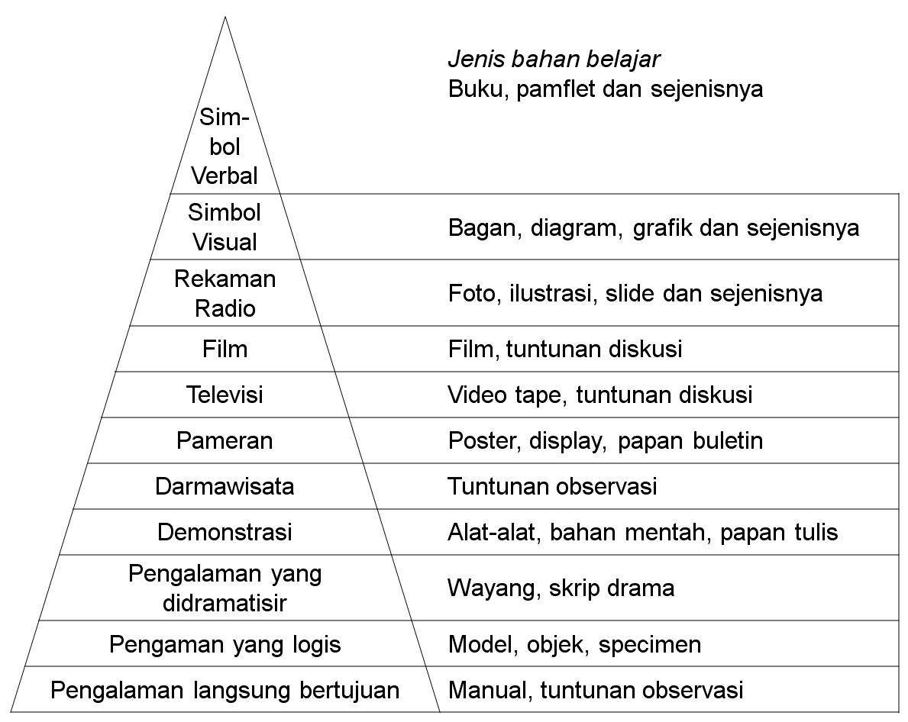
Continuation…(MENGELOLA DAN MELAKSANAKAN PENGALAMAN BELAJAR)
EDGAR DALE’S EXPERINCE

Slide 10
G. EVALUATION OF THE LEARNING OUTCOMES AND REDIAGNOZING OF THE LEARNING NEEDS
Evaluation of learning outcomes is basically to measure the change in behaviour. In general, the learning outcomes in any given learning activity will influence the participants in two ways:
First, the participants will have their own perspective towards the weaknesses and strength of the model of behaviour required.
Second, they will realise that the model has changed their way of thinking step by step, to the extent that a change will be realised between the way they perform in comparison to the previous.

